Slide 1
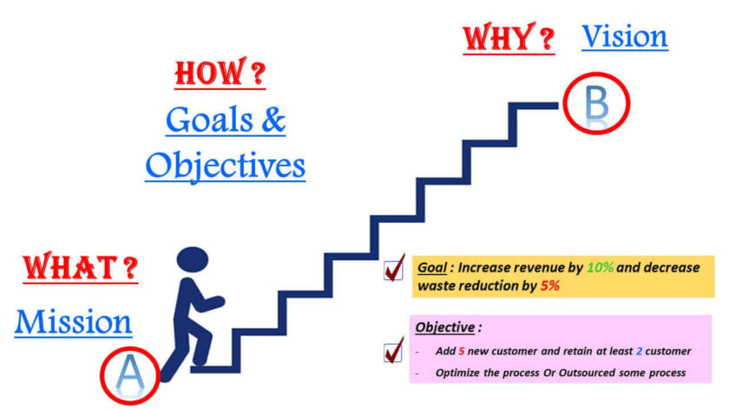
VISION, MISSION, OBJECTIVES AND STRATEGY

Slide 2
Vision
Vision statements are considered as a critical component in any strategic plan and the reason is because these strategic plans are all about creating a different future which is then articulated in your vision statement.
Vision statement needs to be concise and clear but it needs to paint a picture for where you are going and why you want to go there.
And that’s your critical word here is to remember, is “Where.” Where are you going as a company? What does success look like in the future for you?

Slide 3
Vision talks about “Where” does one wants to reach in Future say for e.g. 5 years or 10 yrs. from now”.
Example Company XYZ wants to be leader in manufacturing of Electric vehicles.
Vision statement articulates the future of the company where the company is heading towards and lays out what it seeks to become in long terms says for example 5 years or 10 yrs. from now.
Vision provides bases foundation for defining mission statement.

Slide 4
Mission:
Mission talks about “What” is that the reason for your presence of your organization or what’s the fundamental reason why you came in this business ”.
In short, Mission statement is a written description of an organization’s purpose for existing.
Mission statement will help other know what we do and why are we in this business.

Slide 5
Goals:
Goals are defined from what company wants to realize.
It can be profit or good customer service Goals are usually expressed as percentage (%) in measurable terms.
These should be SMART goals where SMART stands for Specific, Measurable, Attainable, Realistic and Time bound.
Say for example our one of goals could be to have 15% increase in revenue or 10% decrease in non-value added activities.
Companies normally define their goals and objectives in their vision and mission statements.

Slide 6
Objectives:
Objectives are the specific actions taken to achieve these goals
Say for E.g. my Goal is to “Increase revenue by 10% and decrease waste reduction by 5%”, then based on this goal I will formalize my objectives based on this goal which can be
-1st goal is “Increase revenue by 10%”
-add 5 new customer and retain at least 2 customer
-2nd goal is “Decrease waste reduction by 5%”

Slide 7
In conclusion;
Vision: Where?
Mission: What?
Objectives: Why?
Strategies: How?

Slide 8
Objectives
Where do you want to be?
Ends Results
Desired outcomes
Means to achieve objectives
How do we get there?
Strategy
Broad Action Plan

Slide 9
Benefit of Strategic Vision:
Provides direction:
Strategic vision provides long-term direction to the organization. It prepares the organization for future.
Guides for decisions:
Strategies vision reflects intent of the organization. It guides strategic decision.
Shapes strategy:
Strategy vision is the future aspiration of an organization. Strategic management always focuses on strategic vision.
Sets priority:
Strategic vision set organizational priority. It further guides planning.

Slide 10
Aligns people and activities:
Strategic vision aligns people and activities across the organization. It enhances organizational effectiveness.
Reflects core values and belief:
Strategic vision reflects the core values and beliefs which the overall management system of the organization.
Empowers employees:
Employee's motivation, commitment and empowerment are vital for organization success. Strategic vision aims employee empowerment to focus their efforts towards it.
Brings change:
Strategic vision intends to brings change in the organization. It acts as the Centre of hope in the organization.

Slide 11
Characteristics of strategic vision:
Directional: An effective vision provides direction and makes clear where the organization is going. This means that a vision needs to be specific enough to shape decision-making and broad enough to allow innovative strategies for vision realization.
Clear: the vision must clarify focus, and direction to ensure that scare resources are focused on the most strategic initiatives. Clarity allows individuals across the organization to have a shared sense of what's important and what's not, to ensure that they are free to act within those constraints.

Slide 12
Purpose driven: An effective vision provides a larger sense of purpose for the organization and its people. Purpose is about why we exist. Vision connects people to a meaningful purpose, allowing them to feel that they are part of something bigger than themselves.
Challenging: A vision is a goal that should challenge, stretch and set a high standard for the organization. Effective vision represents a future that is beyond what is possible today or what we think possible tomorrow.
Unique: An effective vision reflects what's unique about the organization, it recognizes what makes it different. Vision must make clear the activities that the organization will and will not pursue, the capabilities to be developed.

Slide 13
Vivid: An effective vision provides a vivid mental image of what the organization will be like in the future. Well-crafted vision describes the future in a way that is easy to imagine and to picture in the mind's eye.
Inspiring: An effective vision engaged and inspires people to commit to a cause. Vision appeals to the hearts and minds of people. An effective vision moves you emotionally, creating a desire to sign up to the cause.

Slide 14
Developing Strategic Vision and Mission:
All the factors affecting the SLOC analysis is required within and outside the organization.
Manager from top to bottom level should be involved in developing strategic vision. Participatory involvement enhance the responsibility towards organization.
Collection of different document prepared by different department of manager for the preparation of vision.
There should be the review of related studies i.e. literature review.
Discussion of collected document by manager and modification if necessary.
Final draft of vision is prepared by the collaboration of all participatory employees.

Slide 15
Features of Mission:
Broad in scope
Precise (not more than 250 words)
Multi-components ( market, technology, philosophy, etc)
Distinctive (build of image)
Inspiring
(BIMDP)

Slide 16
Importance of Mission:
Brings uniformity
Base of resource allocation
Develops organizational culture
Enhances employees ownership
Reflects the organizational responsibility

Slide 17
Concept of Objectives:
The expected outcomes of an organization are known as objectives.
They convert the strategic vision into specific performance targets. Objectives show the managerial commitment towards performance achievement.
In other words, they are the end result of planned activity.
Each and every organization is established for achieving certain objectives.
Hence, the organizational activities are directed towards their achievement.
Objectives may be formulated for a long as well short term.
Objectives also reflects the interest of the organizational stakeholders.

Slide 18


Slide 19
Components of Objectives: (SMART)
Specific
Measurable
Achievable
Realistic
Timely
Motivating
Flexible
Hierarchical

Slide 20
Level of objectives:
Corporate level: At this level, objectives reflects the overall scope of organization. The main concern of objectives formulation at this level is how to run a firm in structural and financial term and how to allocate resources optimally to different operations and activities.
Business level: At this level, objectives are formulated to compete in the market. Business level objectives try to express, for examples, which specific product will be selected to compete on a low cost basis in the market to achieve organizational objectives.

Slide 21
Functional/Operational level:
Objectives express how marketing, finance, human resource functions help to achieve competitive advantage. Objectives state about product promotion, training, development and risk management.
Individual/Operating unit level:
Objectives are formulated to express responsibility of plant managers, geographic unit managers and frontline managers operating units. With such objectives organization can easily compete in the market to get competitive advantage.

Slide 22
Crafting Objectives:
Increase profitability: Strategic management is concerned with getting competitive advantage from the market. Its bottom line is to earn profit and return on investment in the business.
Increase productivity: It refers to the maximum level of outputs with minimum inputs. Objectives are set for the efficient use of organizational resources, such as machine, labor, information etc. to increase the productivity.
Extended product: Objectives are set to express how a firm will to extended its product line or develop a new product, undertake product research etc. such an expression will help to recognize how the firm is achieving its product planning and strategies to take a competitive advantage in the market.

Slide 23
Express competitive position in the market: After setting objectives organizations make their competitive positions clear in front of their competitors. For examples, a firm tries to indicate through its objectives that it needs to achieve the first position in the market in terms of sales volume.
Develop employees: Organizations seek to enhance capacities compared to those of the competitors by developing knowledge and skills of their employees. They state explicitly through the organization objectives their needs to develop employees to make them prepared to compete in the market. Objectives are also required in enhancing core competency, productivity and quality of work life etc.
Strengthen employee relations: Organization set objectives to improve employee relations. In order to get a competitive advantage, it is essential that there be a harmonious relation between management and employees. This is possible when the management acts for maximizing welfare and interest of working people in the organization.

Slide 24
Manage physical facilities: Objectives are set to manage a firm's physical facilities. It includes the firms long range objectives of increasing production capacity or decreasing space due to the effect of e-commerce. To use physical facilities strategically it is essential to formulate explicit objectives detailed with required time and budget.
Take technological leadership: Organization set objective to make efficient use of the available technological and be a technology leader in the market. Some business organization are opting for very efficient technology to make the quality of their product better than those of their competitors.

Slide 25
Difference between financial and strategic objectives:
 | Strategic Objectives | Financial Objectives
1 | Objectives that are competition focused and aim to be a best player in its market or industry. (Bigger market share, new segments, Differentiation, Cost rationalization, improve supply chain, electronic commerce. | An objective set by a company in which the target state is measured in monetary terms, such as a certain amount of profits, or a certain percentage increase in profits over a period of time.
2 | long term 5-10 years, | Short term 2-3 years,
3 | The strategic plan provides the direction towards achieving the strategic objectives (vision of the company) | financial plan shows the direction towards achieving financial objectives.
4 | strategic plan is required to align the resources according to the ultimate objectives of the company. | A financial plan is required to manage the cash flows within the company
5 | wide range coverage | limited scope

Slide 26
Difference between Mission and Vision
Aspect | Mission Statement | Vision Statement
Purpose | Defines the organization’s purpose and primary objectives | Outlines the organization's aspirations and future direction
Focus | Present: what the organization does now | Future: what the organization aims to become or achieve
Components | Core values, target audience, key services/products | Long-term view, inspirational, motivational
Duration | Stable over time but may evolve | Timeless but can be revised
Scope | Specific, detailed, actionable | Broad, overarching, visionary
Example | "To provide high-quality education for student success" | "To be a global leader in innovative education"

